Slide 1
Long Term Fruitfulness: The Importance of Member Care in Missions
Notes:
Thanks to Pastor Jonathan for asking me to share. We believe strongly in partnership and for us to get the job done of proclaiming the gospel where it has not been shared I want to say that we need each other!
I serve as an Area Director for AGWM which means I oversee a 5 country area where we have workers placed. In three of those countries we have a national church and in two we do not.
I also travel to our headquarters 3 times a year to train new workers coming to the field and I read application files and do interviews with people applying to serve in missions. There is not a more exciting times in people’s lives than when they are pursuing missions appointment. And when things don’t go well I’m also there – hearing the struggle and the overseeing departures & dismissals from the field.

Slide 2
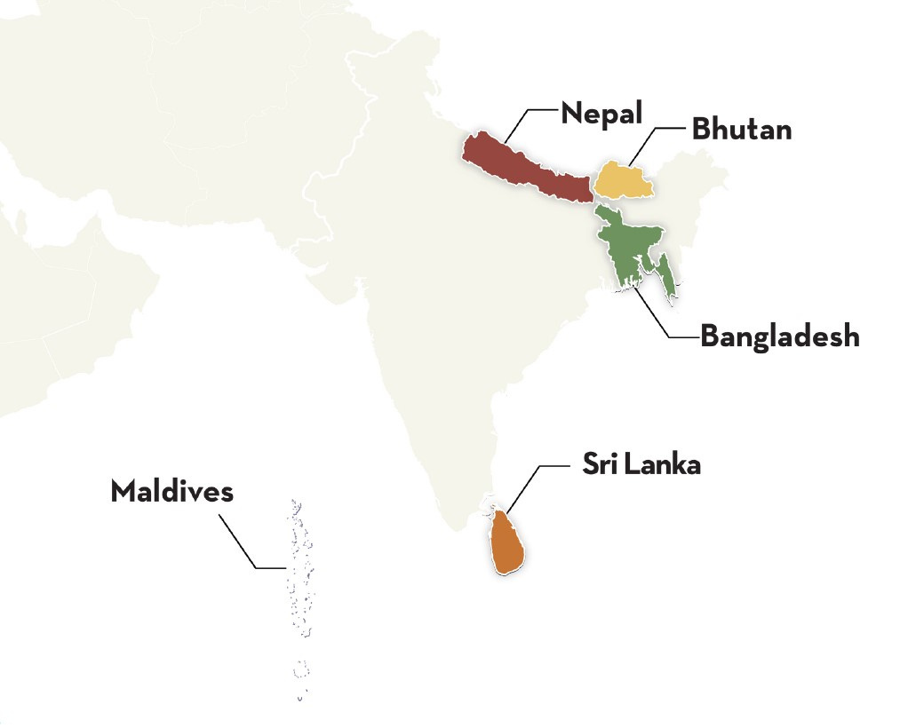
99%
Unreached
1%
Reached
Notes:
All the easy places of ministry have been taken and what remain are difficult places where the enemy has been able to rule & reign for decades and centuries. This does not negate the call to go but we must help our people in these contexts.

Slide 3
Matthew 13:24-27
The Kingdom of heaven may be compared to a man who sowed good seed in his field, but while his men were sleeping, his enemy came and sowed weeds among the wheat and went away. So when the plants came up and bore grain, then the weeds appeared also. And the servants of the master of the house came and said to him, “Master, did you not sow good seed in your field? How then does it have weeds?

Slide 4
Matthew 13:28-30
He said to them, ‘An enemy has done this.’ So the servants said to him, ’Then do you want us to go and gather them?’ But he said, ‘No, lest in gathering the weeds you root up the wheat along with them. Let both grow together until the harvest, and at harvest time I will tell the reapers, “Gather the weeds first and bind them in bundles to be burned, but gather the wheat into my barn.”’”

Slide 5
Biblical Foundation: Matthew 13:24-30; 36-43
The sower planted the wheat in the field
An enemy sowed negative seed that appeared as wheat
Let the two grow together
Our tendency is to work our way ”out of the field” and ease our suffering
Transformation of the field requires that the head of wheat die and seed fall into the ground

Slide 6
Longevity
People often over-estimate what they can do in a year and under-estimate what they can do in a lifetime.
– Bill Gates
Notes:
Yesterday Pastor Asa reminded us that the book of Acts spans a period of time about 30 years. Things don’t transform overnight – we need long term workers. I think we sometimes forget what a loss it is when someone leaves the field. Think for a moment about all the time, funds and energy invested in getting one worker to the field, getting them set up, the relationships they build etc. We want to protect that investment!

Slide 7
What is Member Care?
It is not an attempt to remove people from growth opportunities or challenges in their ministry
It is to help people recognize and and acknowledge challenges
Provide support where it is needed (counseling if needed)
Build Christ centered resiliency in our work
Notes:
2. Recognize and acknowledge challenges – there are some things I cannot fix for you. McDonalds is not coming to Nepal, I can’t fix you being present when disaster strikes your family and you aren’t there.
3. Not all counseling is created equal – also counseling should not go on infinitely. A good counselor is listening, giving homework and helping you process to bring about change
4. Resiliency helps you develop tools to remain in the field

Slide 8
Pain points for workers:
Lack of budget / finances
Visa / Identity
Absent Team Leader
Misalignment of expectations
Notes:
Budget:
didn’t raise enough funds to begin with or the budget was/ is unrealistic.
Visa / Identity:
Not clear on what they are doing in the culture and what their identity is in the culture. Or did not obtain a proper visa.
Team Leader:
TL is not present, they are alone and isolated. Please consider sending team wherever possible.
Misalignment of Expectations:
Not sure what they are supposed to be doing day to day or not fulfilled in what they are currently doing (language)

Slide 9
Communicate Expectations:
Do this frequently and often as you have time to meet with your personnel
Success is obedience to Jesus early on
Practice the disciplines of a church planter
Personal Development Measures with a monthly review

Slide 10
Contributing Factors that lead to departure from the field:
Children who struggle to adjust
Aging Parents
Empty Nest (re-patriation of children back to the passport country)

Slide 11
Self Care Keys
Abide Daily
Sabbath Weekly
Detach Frequently
Revisit Calling
Notes:
Abiding – what does that look like for you?
John 15 & Galatians 5:22-26

Slide 12
Roles & Responsibilities:
You are a follower of Jesus first – ministry is what you do not who you are!
Next, you are a husband or wife
Parent
You have a calling and assignment. Calling remains but assignments can change.
Notes:
Take care of your family – emphasize with children what they do have and not what they don’t.
Spousal support of the call

Slide 13
“I have never been happier in my life. Aiden loved Jesus Christ, but Leonard loved me.” -Ada Tozer
Notes:
I can make a strong argument that we should do both!

Slide 14
Considerations:
How will we re-patriate in times of crisis?
If deaths or sickness occurs in a family what is possible?
How will you recognize special days, milestones and transitions?
Are field visits possible and who will do them?
Are trainings and retreats possible?
Monthly, Quarterly connections
Support for schooling
Notes:
Governments fall, wars break out and crisis hits what plans do you have in place. People need plans even if things don’t always go according to plan.
Not everyone chooses to go home (in fact I’ve been surprised by what some choose to do) but you should communicate this.

