Slide 6
Notes:
> MORE THAN HALF THE WORLD LIVES IN ASIA.
POPULATION: https://www.statista.com/statistics/237584/distribution-of-the-world-population-by-continent/
CHRISTIANS: https://www.pewforum.org/2015/04/02/religious-projection-table/2020/number/all/
Update: https://web.archive.org/web/20220213034818/https://www.pewforum.org/2015/04/02/religious-projection-table/2020/number/all/
World Population 2020: 7.657 billion
Asia: 4.4 billion
Christians = 2.382 billion
Non Chr = 5.275 billion
== Number of Non-C’s ==
N.America = 94 million
L. America = 67 million
Europe = 205 million
Africa+ME = 794 million
Asia = 4.1 billion

Slide 7
Notes:
> ALMOST 80% OF ALL NON-CHRISTIANS LIVE IN ASIA!
POPULATION: https://www.statista.com/statistics/237584/distribution-of-the-world-population-by-continent/
CHRISTIANS: https://web.archive.org/web/20220213034818/https://www.pewforum.org/2015/04/02/religious-projection-table/2020/number/all/
World Population 2020: 7.657 billion
“Christians” in world = 2.382 billion
Non Christians in world = 5.275 billion
== Number of Non-Christians ==
N. America = 94 million
L. America = 67 million
Europe = 205 million
Africa + Middle East = 794 million
Asia = 4.1 billion

Slide 8
Notes:
The greatest number of unreached people groups – are in Asia
Infographic from: http://www.thetravelingteam.org/stats

Slide 9
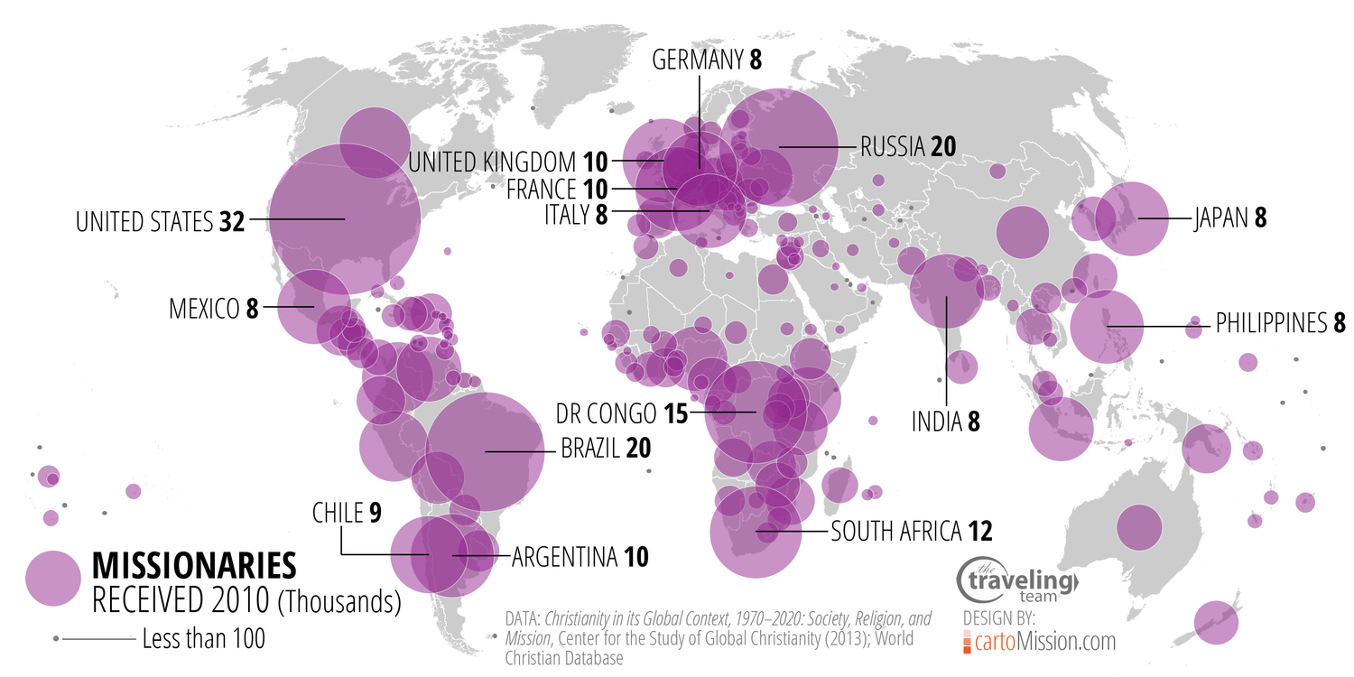
Notes:
YET MOST MISSIONARIES ARE GOING TO “CHRISTIAN” AREAS
Infographic from: http://www.thetravelingteam.org/stats

Slide 10
Notes:
https://www.pwc.com/gx/en/research-insights/economy/the-world-in-2050.html

Slide 11
Notes:
https://www.researchgate.net/publication/359802131_The_economics_of_missionary_expansion_evidence_from_Africa_and_implications_for_development

Slide 17
Notes:
See:
https://www.aboutmissions.org/top-10s.html
COUNTRIES WITH THE MOST
UNEVANGELIZED PEOPLE(2):
1. China................................444,219,082
2. India.................................412,122,495
3. Pakistan.............................83,307,766
4. Indonesia...........................78,805,877
5. Bangladesh........................55,267,877
6. Iran....................................42,507,292
7. Japan.................................41,890,821
8. Turkey...............................34,243,536
9. Vietnam.............................26,516,153
10. Thailand...........................26,509,177

